Slide 1
Exploring and Prediction of Used-Car Market
EMSE 6574
Instructor: Dr. Maksim Tsvetovat
Group Member:
Rui Zhang
Ran Wei
Bite Xiong
Fangzhou Liu

Slide 2
Contents
Introduction and Data Set (fangzhou)
Exploratory Data Analysis (Ran Wei)
Data Preprocessing (Rui Zhang)
Prediction Model (Bite Xiong)
Conclusion

Slide 3
Introduction and Data Set
Create a method to determine whether the price of a used car is appropriate
Cleaning Data sets for 2020 and 2021
Remove unnecessary features
Determine the target price and years(from $320 to $105,000)
Remove outliers (3-sigma rule)
Notes:
Our goal is Exploring and Prediction of Used-Car Market. In our project, we will clean up the target data set and try to do Exploratory Data Analysis. After completing the Data Preprocessing, we will use some modeling to compare and predict to find the best used car.
In the first step, we download the 2020 and 2021 used car datasets from kaggle, and then we remove unnecessary features, and then determine the year and price of the target data range, and then we use the 3-sigma rule to remove outliers in the data set. Finally, the cleaned up data set is obtained.

Slide 4
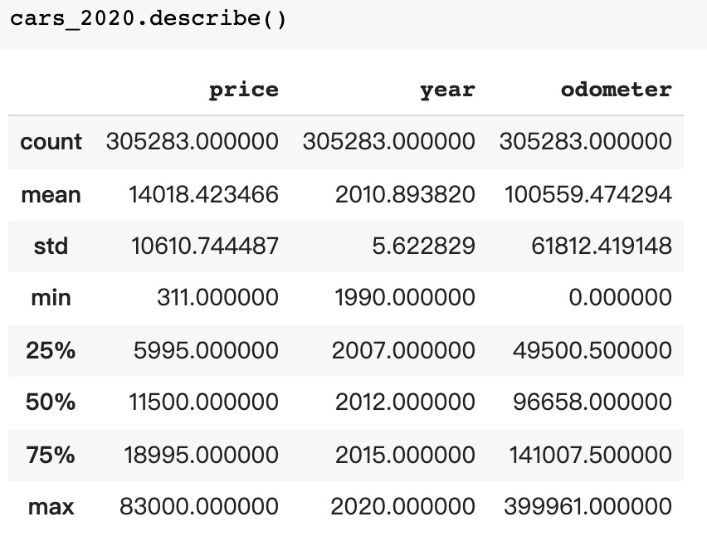
Cleaned 2020 data set

Slide 5
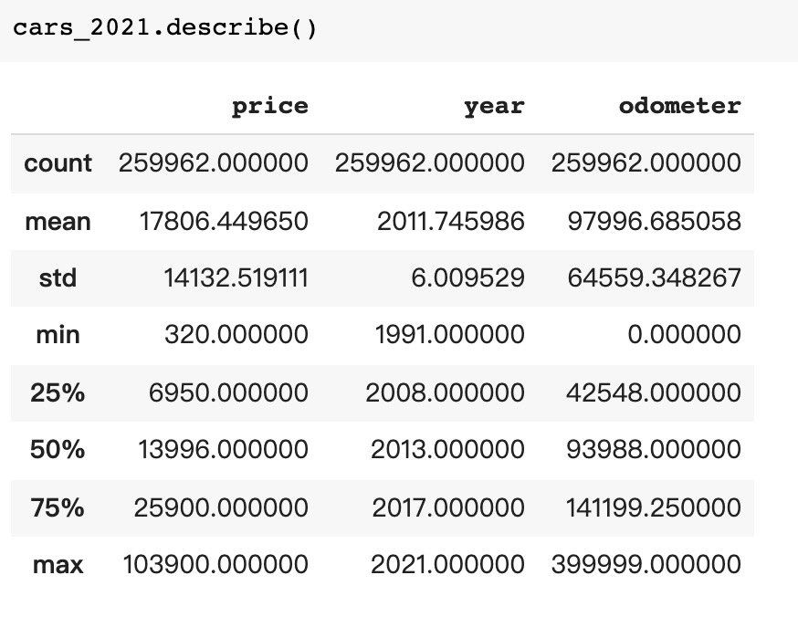
Cleaned 2021 data set

Slide 6
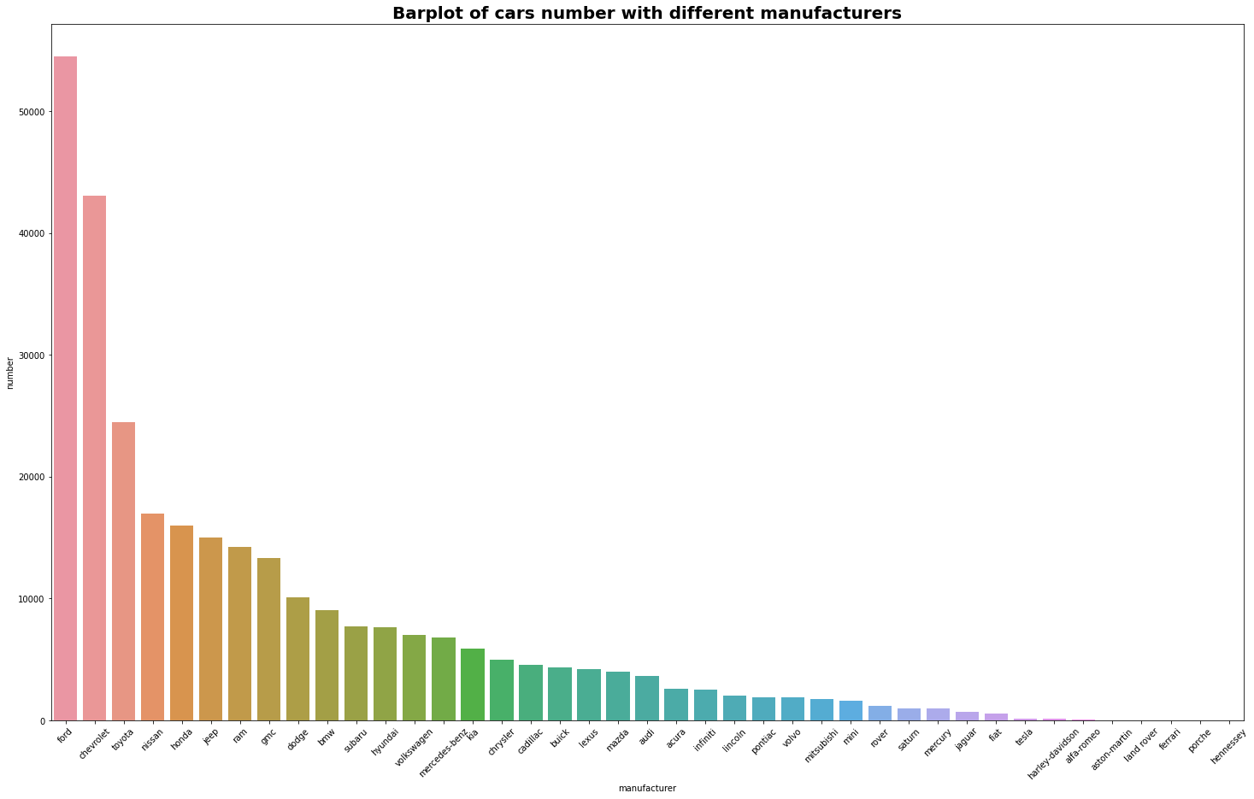
Exploratory Data Analysis
Top Five Popular Brand in 2021
Ford
Chevrolet
Toyota
Nissan
Honda
Notes:
If we want to buy a used car, the first thing may be searching for a target brand.
So as for EDA section, we firstly sort the manufacturers according to their number of cars. Ford and Chevrolet( /ˈʃevrəleɪ/) are among the major manufacturers in America. Japanese cars have a significant share in the used car market, like Toyota, Nissan, and Honda.

Slide 7
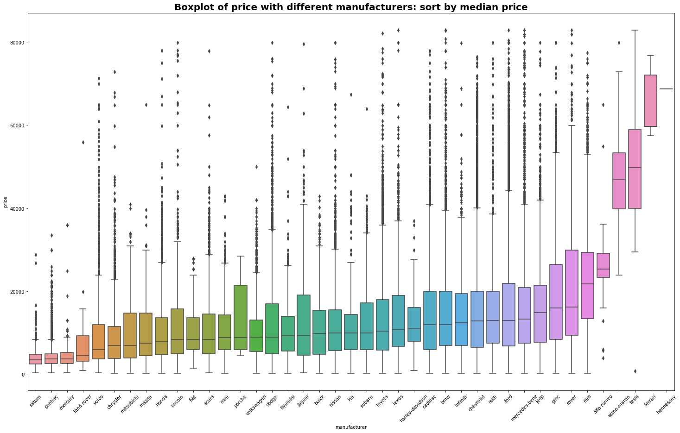
Notes:
As for the price for each brand, we sort the manufacturers by the median price of the car. The median price of our top 5 popular brands are between $14,000 to $16,000.

Slide 8
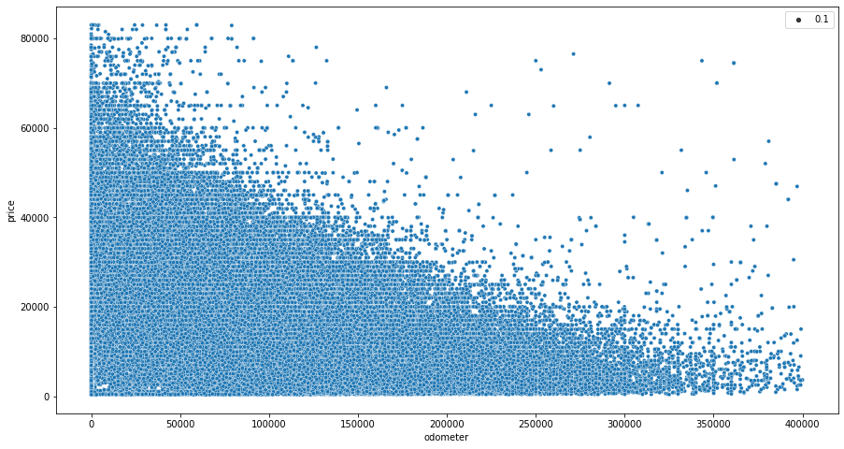
Scatter plot for price and odometer
Notes:
Odometer /oʊˈdɑːmɪtər/ is also an important factor having great influence on the price. Generally speaking, the greater the mileage, the lower the price, which pretty make sense.
In addition, The most common range is between 50,000 and 150,000 miles.

Slide 9
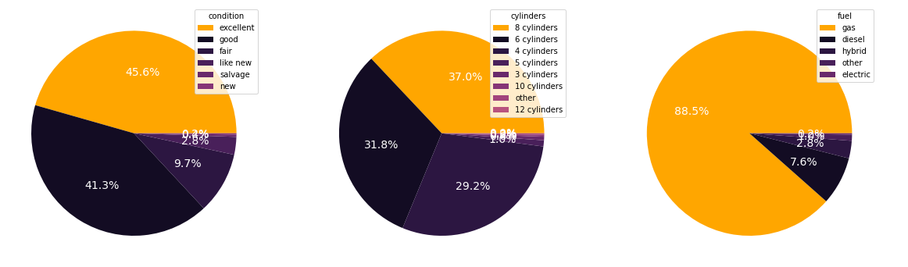
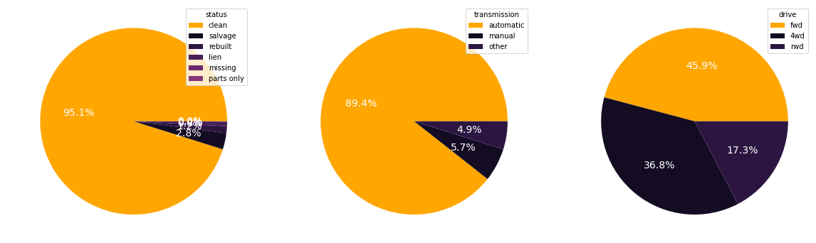
The proportion of values in each category features
Notes:
Then for each categorical features, we conducted pie chart to show the proportion of each unique value.

Slide 10
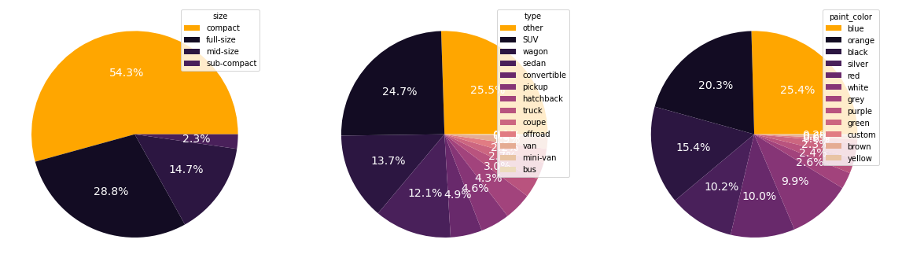
The proportion of values in each category features
Notes:
Over fifty percent of people choose compact used cars because of their more practical size, and everyone has their own preferences when it comes to choosing a car type and color, so this distribution is all relatively even. An interesting point which surprised me is that the most popular color of cars is blue and orange, not black or white. Since I used to suppose that white and black car is more value-preserving than other colors.

Slide 11
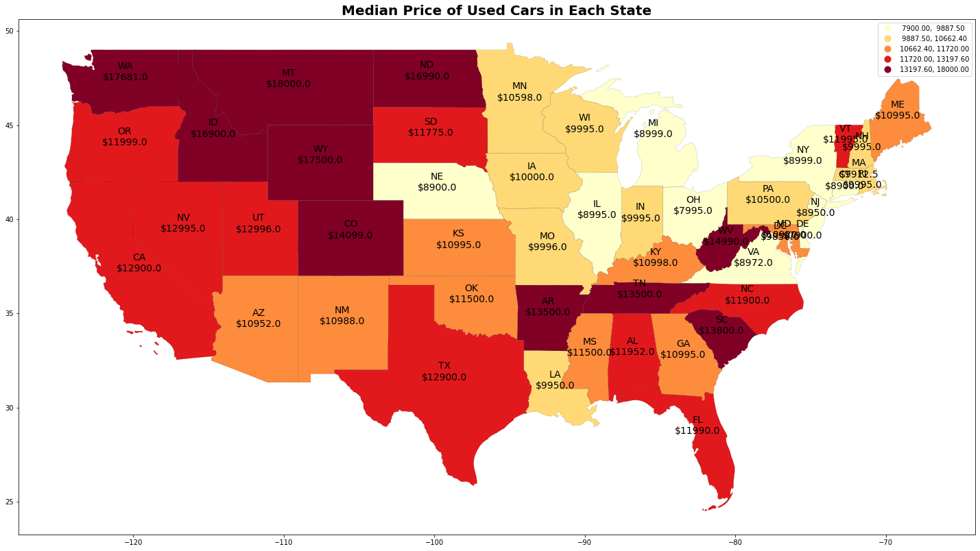
Notes:
To get a general feeling of the whole market situation all over America, we applied geopandas to visualize the price and number data.
The median used car price by state shows that the prices are generally higher in the Southeast than in the Northeast. But the trend in the West is opposite. The car price in Northwest is higher than the Sorthwest.

Slide 12
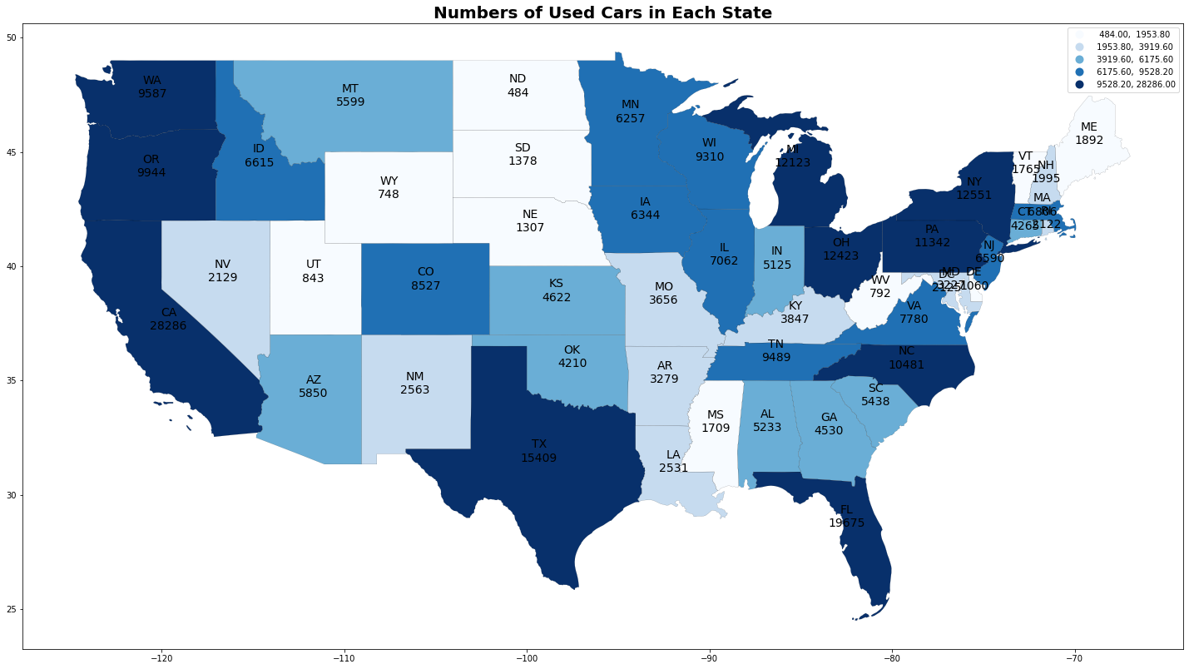
Notes:
And the number of cars concentrate in the state with larger population, like California, Florida, Texas, and New York, which is pretty reasonable.

Slide 13
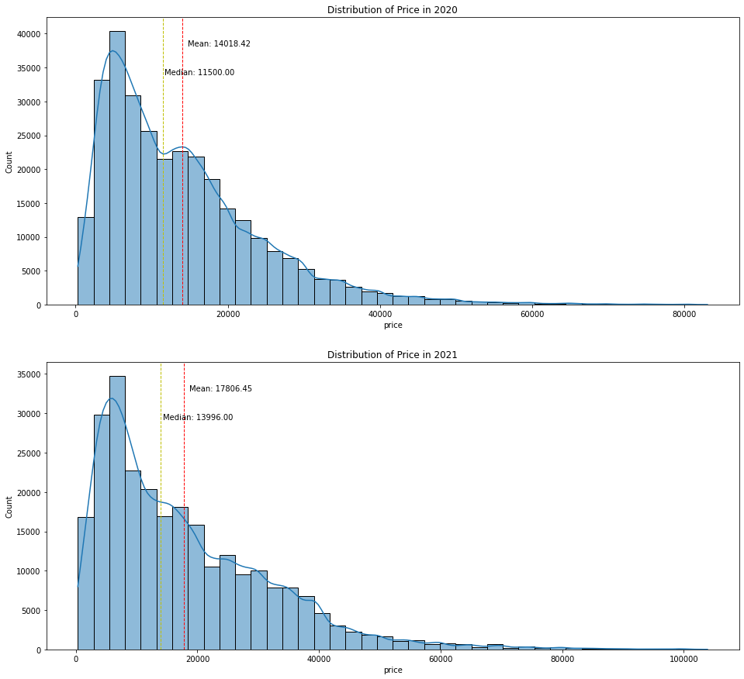
Notes:
We also compared the data from 2020 to 2021.
The median value of used-car price increased 31.6% in general, from $11,500 to $13,996.
It shows that while COVID-19 epidemic recedes, the used-car market is recovering gradually.

Slide 14
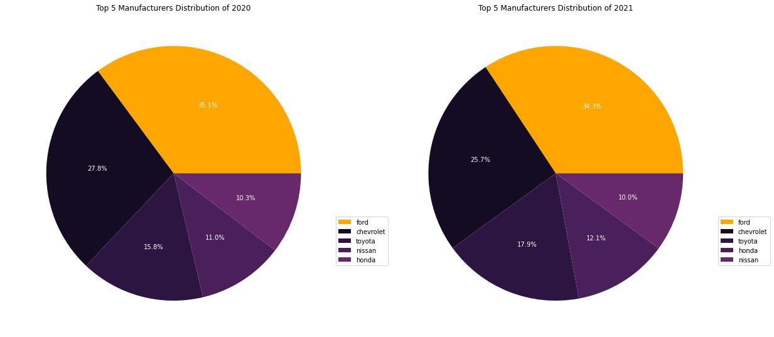
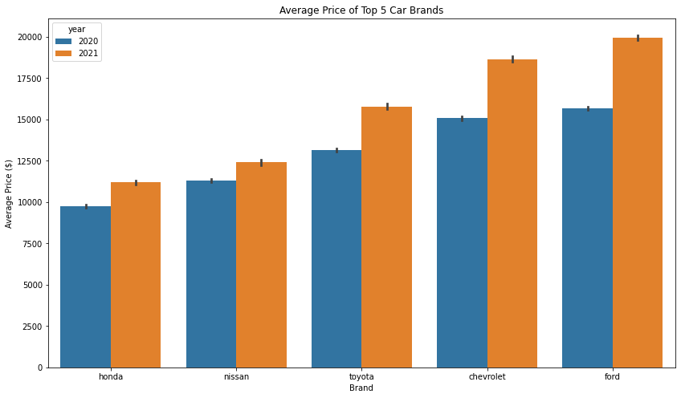
Used-Car Market
2021 V.S. 2020
Notes:
As for the top popular manufacturers, although Ford , Chevrolet and Toyota remain to be the Top 3 , there was a decreasing trend in market share of Ford and Chevrolet while the share of Toyota increased. This might because that during economic recession, Japanese cars are more popular since they are usually more economy with less fuel consumption.
The average car price of the top 5 brands increased at least 17.4% and up to 32.5%, compared with the price in 2020.
So next step is for data preprocessing.

Slide 15
Data Preprocessing
Missing Value
Categorical Features Encoding
Normalize Numerical Features

Slide 16
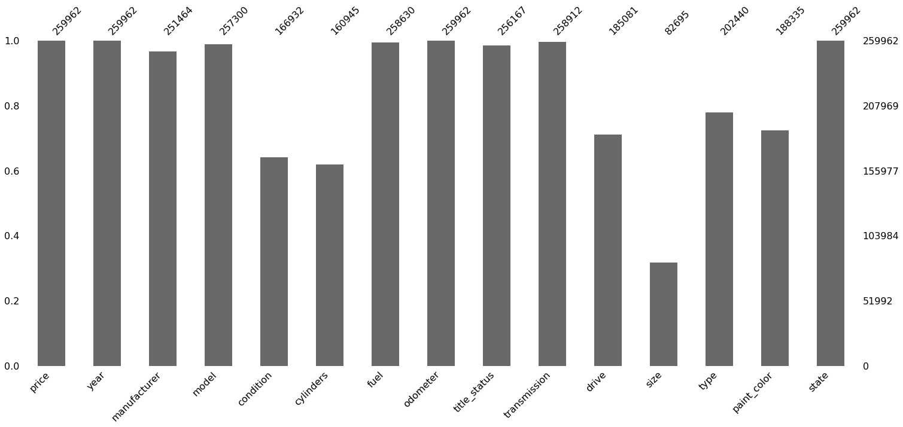
Data Preprocessing
Missing Value
Problem: Most of the categorical data have missing values.
Solution: Fill missing values with”UNKNOWN”.
Notes:
Most of the categorical data have missing values. The simple way is dropping all the rows containing missing values or the removing the whole column. But that will lose so much data and may also lose some important features. So, we filled all the missing values with UNKNOWN.

Slide 17
Data Preprocessing
Categorical Features Encoding
Problem: More than 27,000 car model names lead to too many features after One-Hot Encoding.
Solution: Group car model names by fuzzy matching.
Combine manufacturer and model names
Group basis:
70 Groups
Compute fuzzy matching ratio and group
Encoding by using get_dummies
manufacturer | model
gmc | sierra 1500
chevrolet | silverado 1500
manufacturer model name
gmc sierra 1500
chevrolet silverado 1500
group
gmc
chevrolet silverado 1500
get_dummies
179 dummy variable
Notes:
Popular method to encode categorical data are One-Hot Encoding and Label Encoding. Label encoding is suitable for the case where the feature is ordinal, it doesn’t fit into our case. So, using One-Hot Encoding will be better. But the problem is there are more than 27,000 car model names in our dataset. That will lead to too many features after Encoding.
Our solution is grouping car model names by fuzzy matching.
Fuzzy Matching has a ratio function that computes the similarity ratio between two strings.
The steps of encoding is like this:
Steps: 1. Combine manufacturer names and model names, we named them as manufacturer model name
2. We first choose top 30 popular manufacturer model names as group basis, like chevrolet silverado 1500. But those popular model names cannot cover all manufactures. So, we add all manufacture names into group basis too, like gmc. Finally, we got 70 groups.
3.The third step is the crucial one. We use fuzzy matching to compute similarity ratio between manufacturer model name and each value in group, then sorted the manufacturer model names into the group with the highest matching ratio. Like gmc sierra 1500 is sorted into the group gmc, because gmc sierra 1500 is not a popular model name. Chevrolet silverado 1500 will be sorted into the group with the same name, because it belongs to top 30 popular model names.
4. We put all car model names into 70 groups and encode them by using get_dummies, got 179 dummy variables in total, it’s much less than 27,000.

Slide 18
Data Preprocessing
Normalize Numerical Features
Problem: Some of numerical features have different ranges, may affect model results.
Solution: Normalize numerical features by using MinMaxScaler.
Notes:
Some numerical features have different ranges, especially odometer, it’s max value as high as 400,000 miles, this may affect model results. So, we normalize them by using MinMaxScaler.
And now our data is ready for prediction model.

Slide 19
Prediction Model
Train Test Split
Fit Model
Good/Bad Deal & Find a Best Car

Slide 20
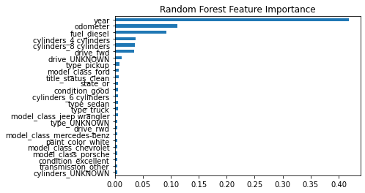
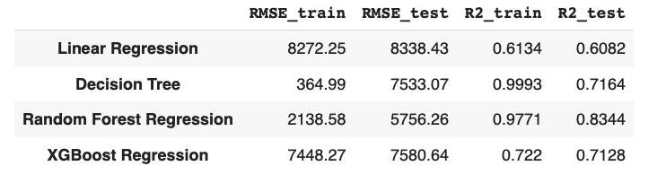
Prediction Model
Train Test Split
Train Data | 174174 (67%)
Test Data | 85788 (33%)
Fit Model
Notes:
We splitted the data into train data and test data, the test size is 0.33.
We tried several models to predict the price of the used cars, for instance, Linear Regression, Decision Tree, XGBoost and Random forest. We find that the random forest tree regressor have the best result in general. The most important feature is ‘year’, followed by ‘odometer’.

Slide 21
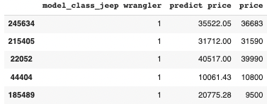
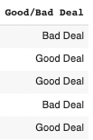
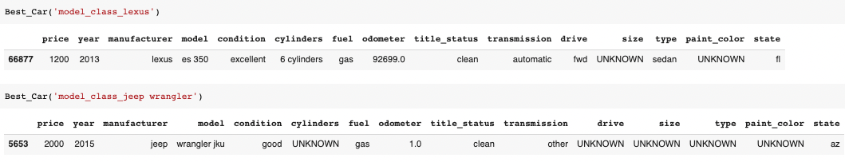
Prediction Model
Good/Bad Deal & Find a Best Car
Determine whether it is good deal or bad deal
Find the best car in Lexus
Find the best jeep wrangler
Notes:
Then we compared the predict price of Random Forest Tree Regressor with the original-data. If the predict price is higher than the price in original-dataset, then we think that it is a good deal for the customers.
What’s more, we also defined a function to find a best used car by finding a relatively high predict price and relatively low selling price. In this slide we can see that there is a lexus es350 2013 sells for only 1200$,
a nearly new jeep wrangler jku is 2000$.

Slide 22
CONCLUSION
Final Paper:
https://docs.google.com/document/d/1F4m_1mJYTmVqU45oO-i5lj7URbOjNtJG1g_fH58TMzs/edit
Github Link: https://github.com/Melody1745/Used_Car_Market_Analysis.git
Colab Link:
https://drive.google.com/drive/folders/1itFGWLRWcPtWGKpcqWCopesh87L0HBUw?usp=sharing
Notes:
To wrap up, we firstly cleaned the data and did the exploratory data analysis. Secondly, we processed the data in order to enhance the prediction accuracy. At last we predicted the price of the used car and tried to find the Good deal and a best car. The more details are provided in the link in this slide.

Slide 23
Thank You
&
Questions？

